Slide 1

House Prices - Advanced Regression Techniques

Slide 2
Presented by
Nasir Uddin Ahmed

Slide 3
Outline
Introduction
Objectives of the project
Methodology
Discussion

Slide 4
Introduction
Predict sale prices of houses by using various aspects of residential homes
Focusing on descriptive and predictive analytics
Applying features engineering

Slide 5
Objectives of the project
Understanding the real meaning of Data, Information and Knowledge.
Applying Exploratory Data Analysis (EDA)
Applying Python Programming Language
Building and Evaluating Machine Learning Models

Slide 6
Methodology
Data Collection
Data Cleaning and Preparation
Exploratory Data Analysis and Feature Engineering
Model Building
Model Evaluation

Slide 7
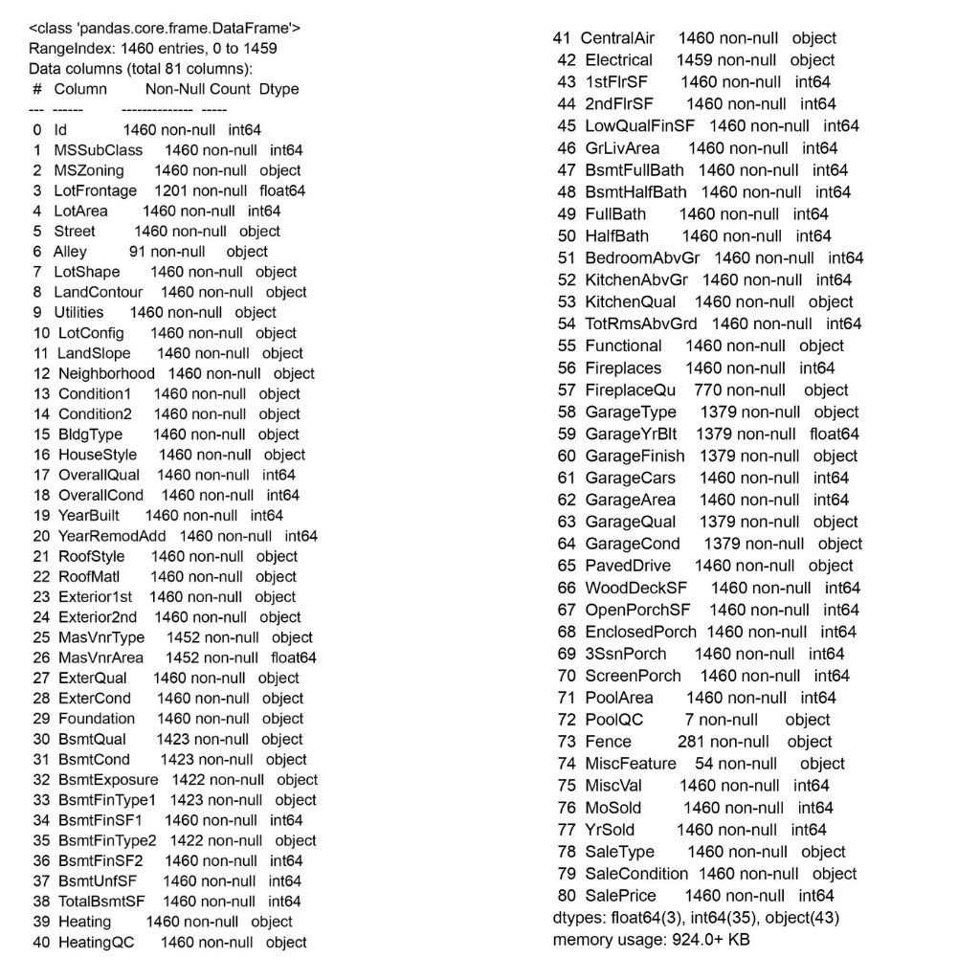
Data Collection

Slide 8
Data Cleaning and Preparation
Handle missing data
Selecting important features
Finding outliers

Slide 9
Exploratory Data Analysis and Feature Engineering
Investigate the distribution of numerical features
Investigate the correlation of these numerical features with ”SalePrice” and drop any features that have low correlation
Deal with missing values through imputation
Operating with Numerical and Categorical Features

Slide 10
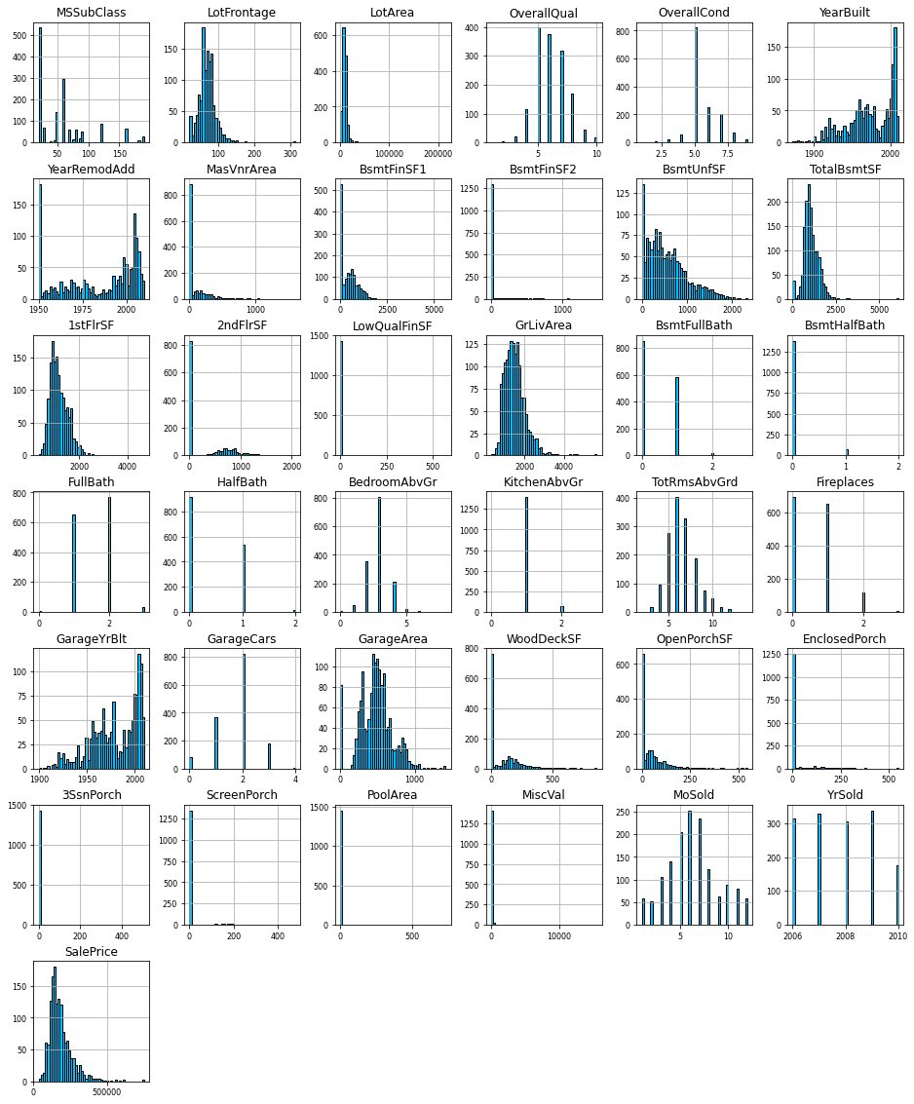
Exploratory Data Analysis and Feature Engineering (Numerical Features)
Initially 37 Numerical Features
Handling discrete and continuous variables, based on the distribution of the numerical features
Dropping variables where 95% of the values are similar or constant.
Retained 35 features

Slide 11
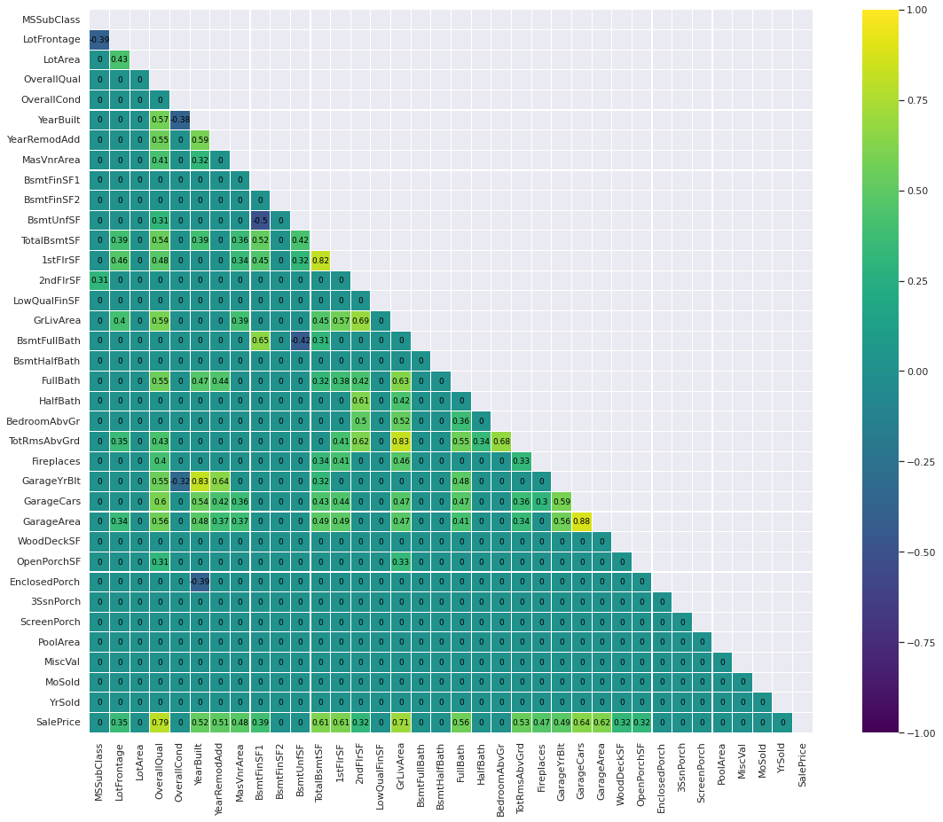
Exploratory Data Analysis and Feature Engineering (Numerical Features Co-relation)
18 of the numerical features has some noticeable correlation with ”SalePrice”
Low correlation with ”SalePrice” is likely not to have a huge impact on the final sale price of the house, any variables with correlation less than 0.3 replaced by 0 for simplicity.

Slide 12
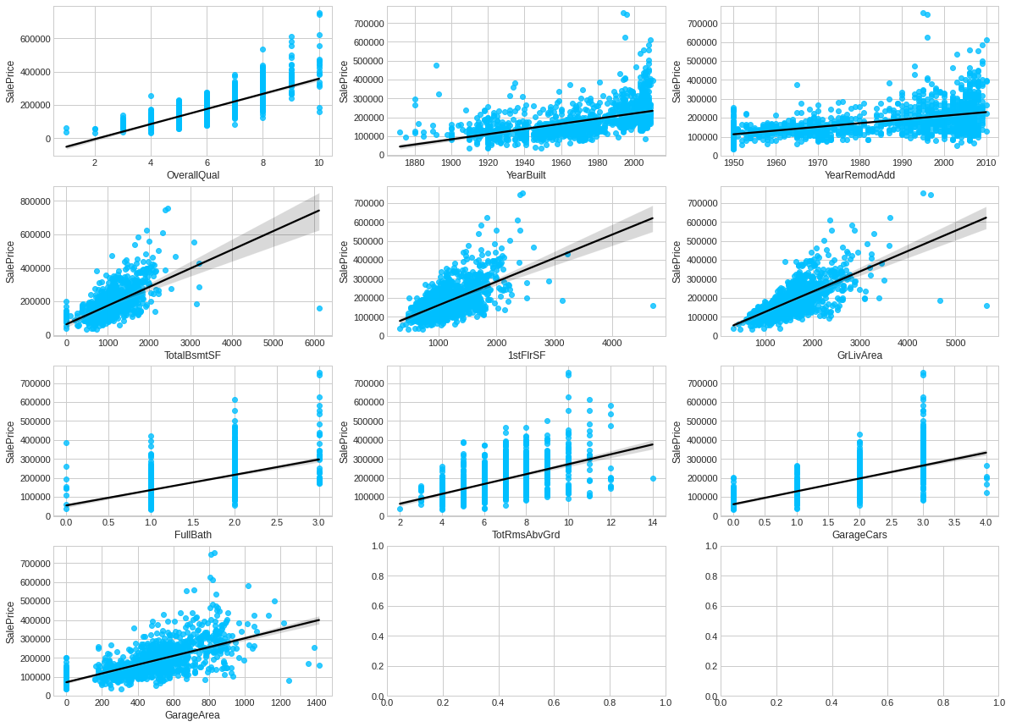
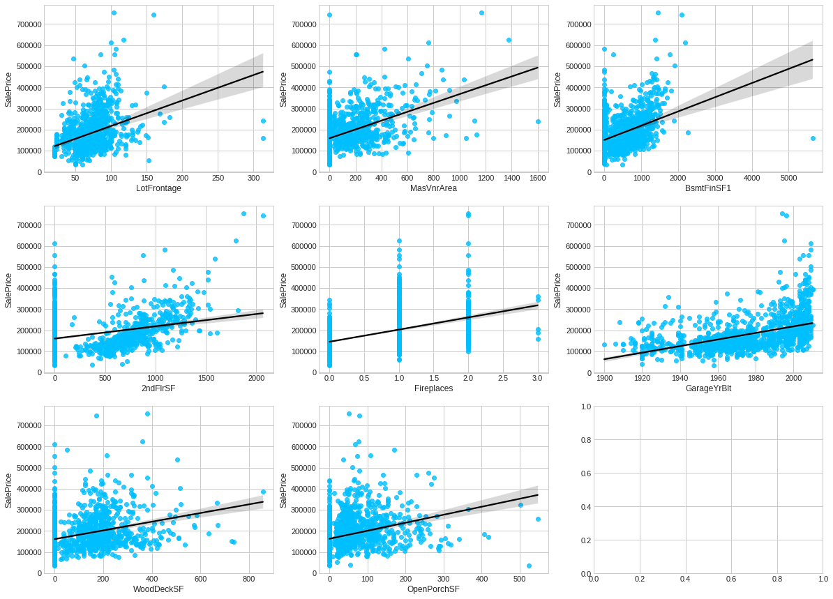
Exploratory Data Analysis and Feature Engineering (Numerical Features Co-relation)
Features with high correlation (higher than 0.5)
Features with low correlation (between 0.3-0.5)

Slide 13
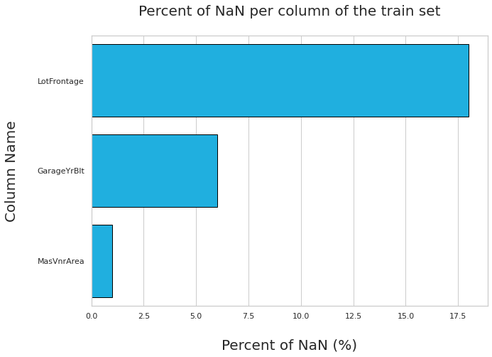
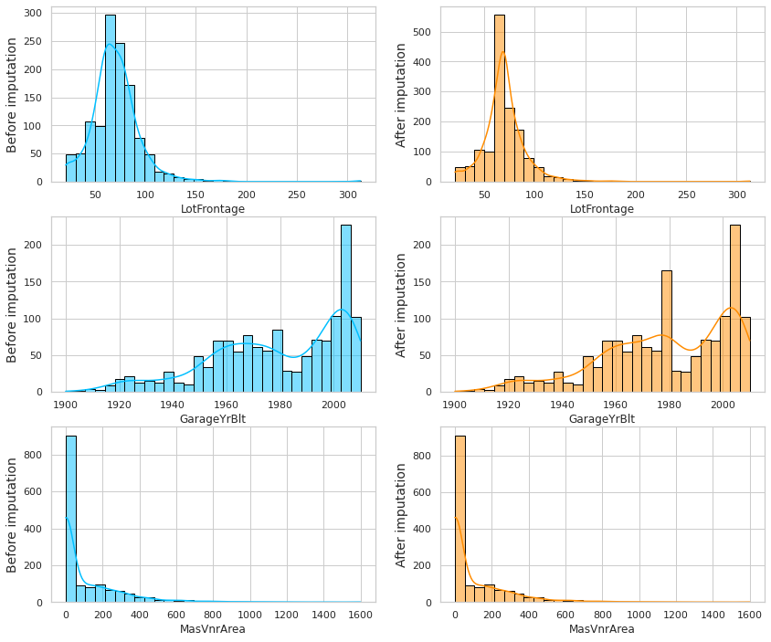
Exploratory Data Analysis and Feature Engineering (Numerical Features Missing Values Train Set)
Percent of NaN per column of the Train Set
Distribution of each imputed feature before and after imputation (Train Set)

Slide 14
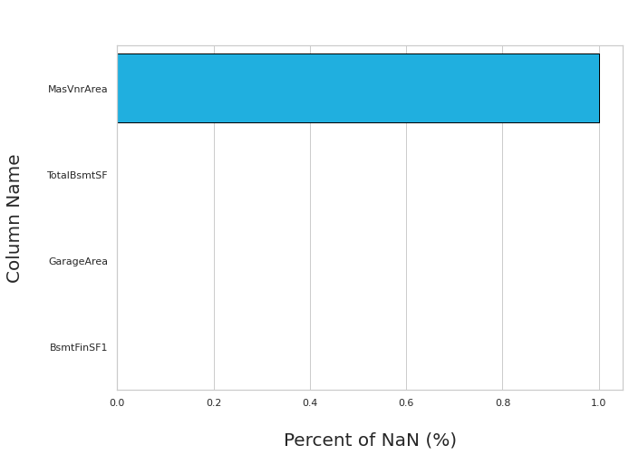
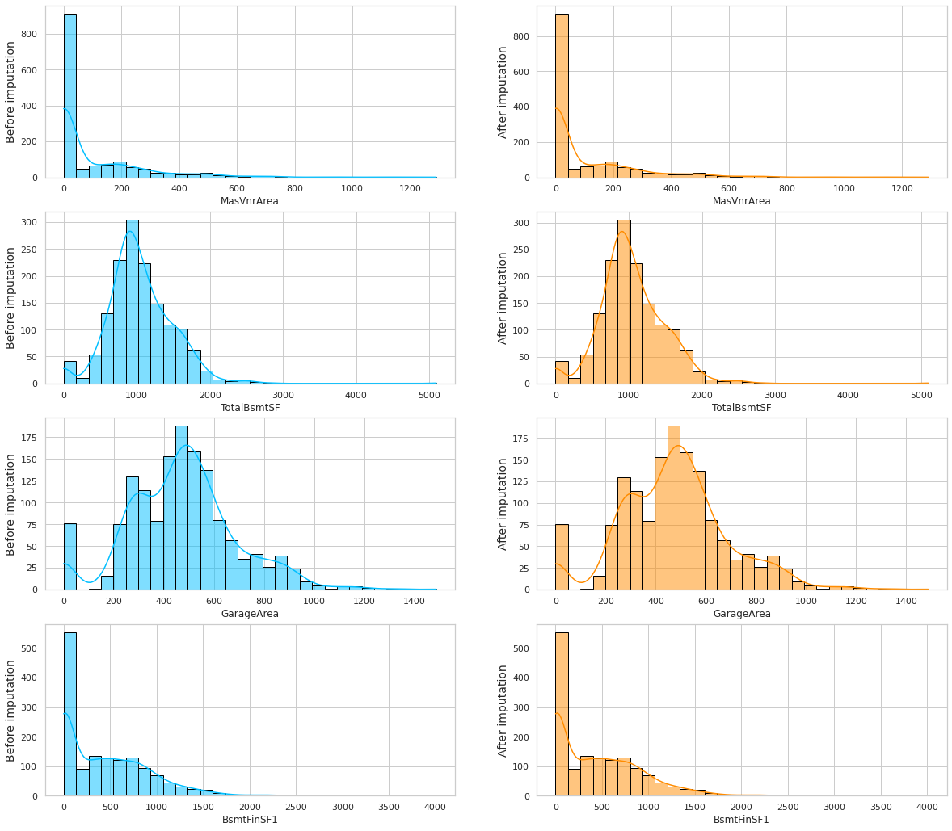
Exploratory Data Analysis and Feature Engineering (Numerical Features Missing Values Test Set)
Percent of NaN per column of the Test Set
Distribution of each imputed feature before and after imputation (Test Set)

Slide 15
Exploratory Data Analysis and Feature Engineering (Numerical Features Summary)
Total 37 Numerical Features
Based on histogram, variables where 95% of the values are similar or constant, were dropped and number of numerical features become 35
Based on co-relation and analysis, Training set shape (Numerical features): (1460, 18), Test set shape (Numerical features): (1459, 17)
Missing value analysis and filling up by mean Training set shape (Numerical features): (1460, 16), Test set shape (Numerical features): (1459, 15)

Slide 16
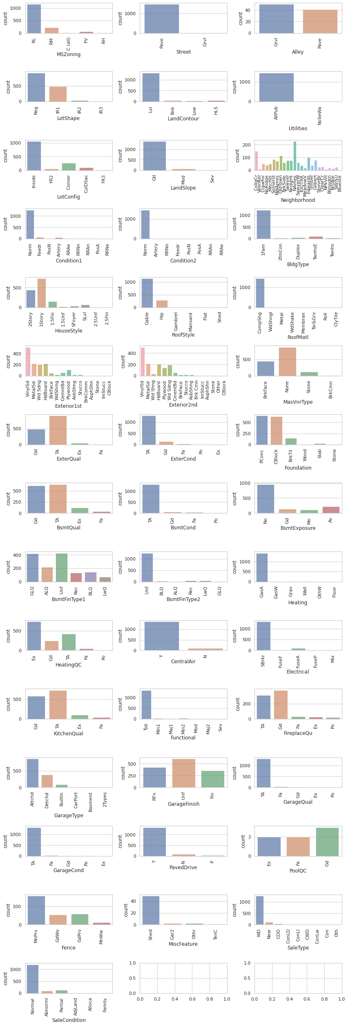
Exploratory Data Analysis and Feature Engineering (Categorical Features)
Initially 44 Categorical Features
Some variables highly dominated by one feature
Variables dominated by one outcome will be removed from both datasets
After dropping, Training set shape (Categorical features): (1460, 29) Test set shape (Categorical features): (1459, 28)

Slide 17
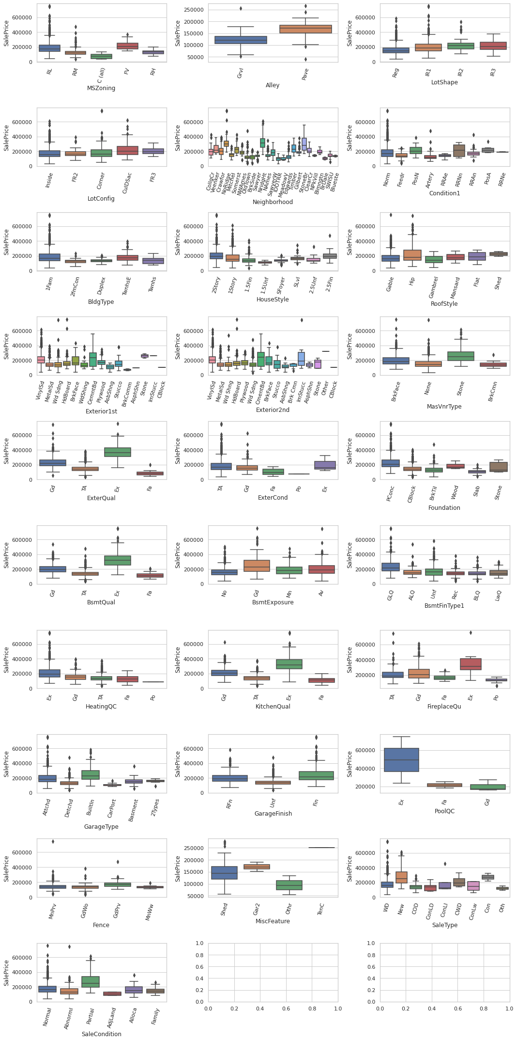
Exploratory Data Analysis and Feature Engineering (Categorical Features)
Variation of the target 'SalePrice' in each of the categorical features
Certain categorical variables are co-dependent on each other
Chi-squared test to be done for each pair of variables at a 5% significance level

Slide 18
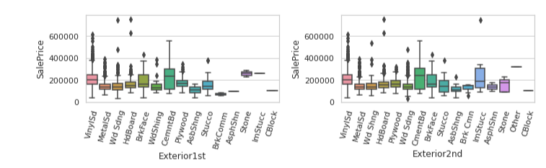
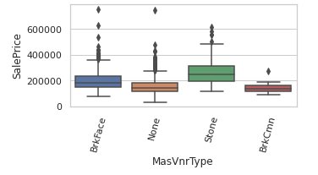
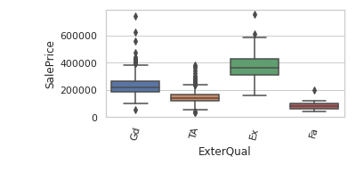
Exploratory Data Analysis and Feature Engineering (Categorical Features)
Three pairs of categorical variables for which the distribution of sale price is very similar
"Exterior1st" and "Exterior2nd"
"ExterQual" and "MasVnrType"
"BsmtQual" and "BsmtExposure"

Slide 19
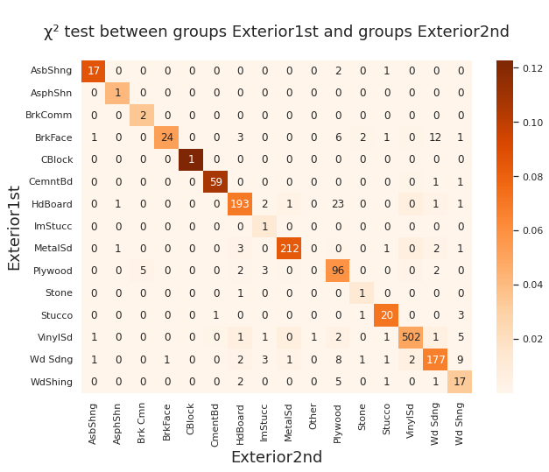
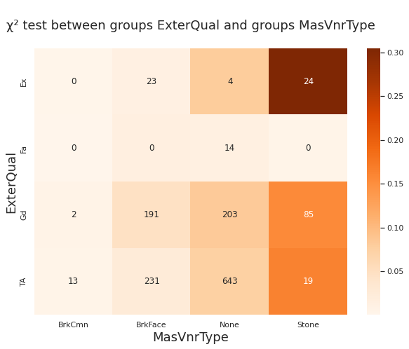
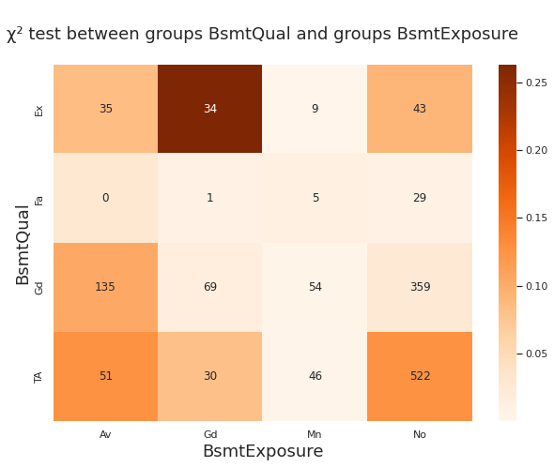
Exploratory Data Analysis and Feature Engineering (Categorical Features)
P-Value of the ChiSq Test bewteen Exterior1st and Exterior2nd is: 0.0
P-Value of the ChiSq Test bewteen ExterQual and MasVnrType is: 1.018755467e-54
P-Value of the ChiSq Test bewteen BsmtQual and BsmtExposure is: 3.879216e-32

Slide 20
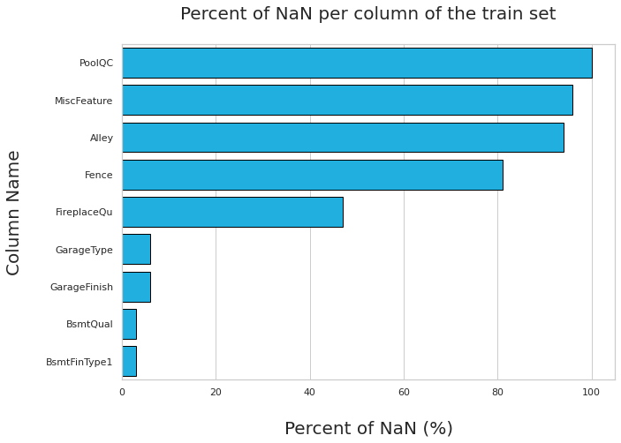
Exploratory Data Analysis and Feature Engineering (Categorical Features Missing Values Train Set)
Five categorical variables that have a significant amount of missing values
Remove any columns with more than 30% NaN entries from both datasets.
Imputation will be used to fill in the missing entries of remaining columns

Slide 21
Exploratory Data Analysis and Feature Engineering (Categorical Features Missing Values Test Set)
Less than 5% NaN values
NaN entry to be filled by co-responding modal class
Training set shape (Categorical features): (1460, 21) Test set shape (Categorical features): (1459, 20)

Slide 22
Exploratory Data Analysis and Feature Engineering (Categorical Features Summary)
Initially 44 Categorical Features
After Count Plots and analysis Training set shape (Categorical features): (1460, 29) Test set shape (Categorical features): (1459, 28)
After Box Plot and Chi-squared test and analysis Training set shape (Categorical features): (1460, 26) Test set shape (Categorical features): (1459, 25)
After handling missing values Training set shape (Categorical features): (1460, 21) Test set shape (Categorical features): (1459, 20)

Slide 23
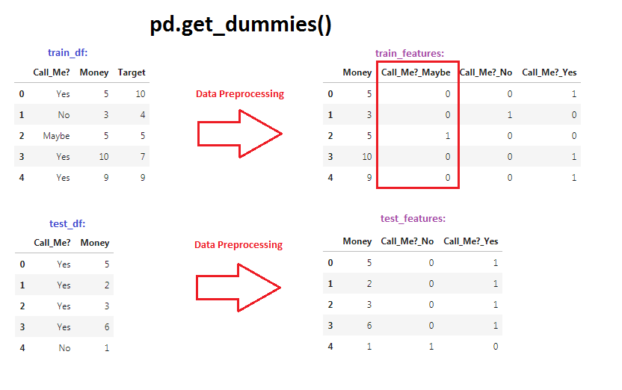
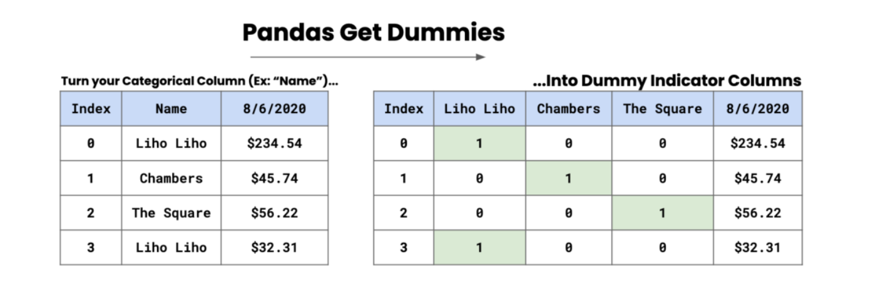
Exploratory Data Analysis and Feature Engineering (Categorical Features)
Transforming the categorical entries into numerical entries
get_dummies() function used
Categorical features transformed into a binary feature
Training set shape (Categorical features): (1460, 137) Test set shape (Categorical features): (1459, 137)

Slide 24
Exploratory Data Analysis and Feature Engineering (Data Joining)
Adding numerical and categorical datasets together Train set: (1460, 153) Test set: (1459, 152)
Year of construction and the Year of Remodeling variables will be transformed into new variables representing the Age of the House and the Age since the house was remodeled
Considering the continuous numerical variables that are skewed

Slide 25
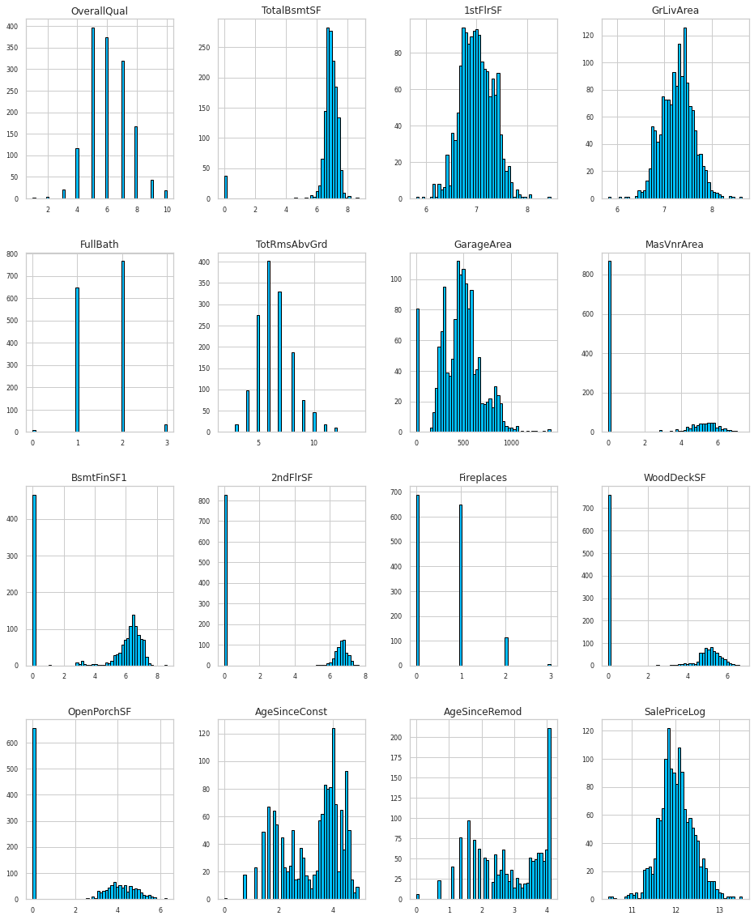
Exploratory Data Analysis and Feature Engineering (Data Joining)
At the start of the project
After features engineering

Slide 26
Model Building
3 supervised learning models considered (Linear Regression, Decision Tree, Random Forest)
X_train:(1168, 152) y_train:(1168,)
X_test:(292, 152) y_test:(292,)

Slide 27
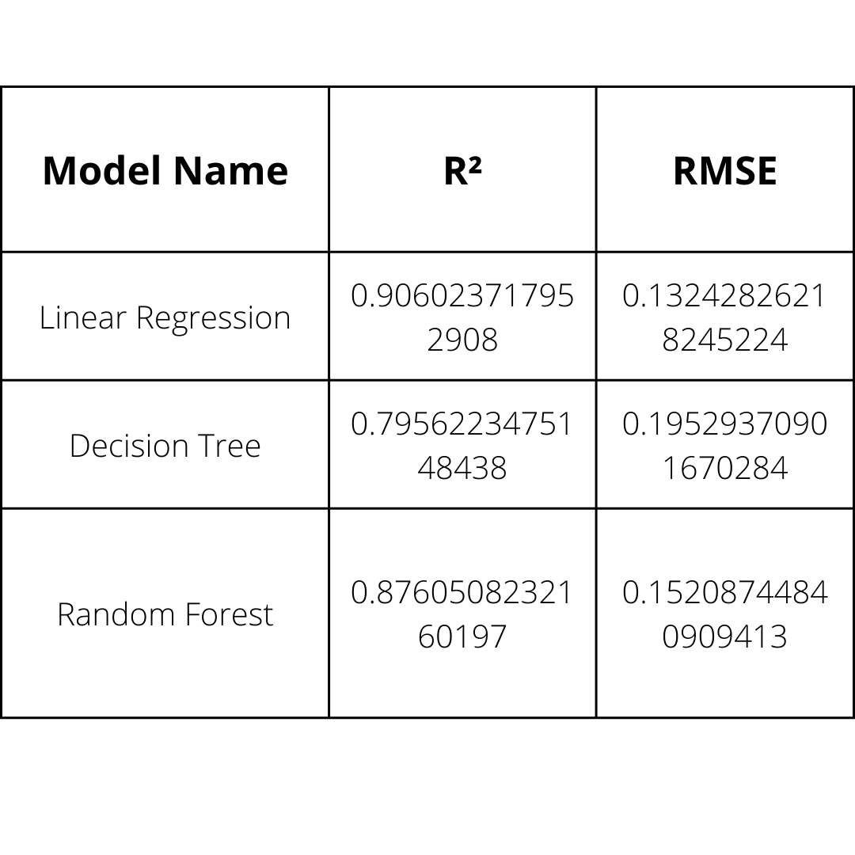
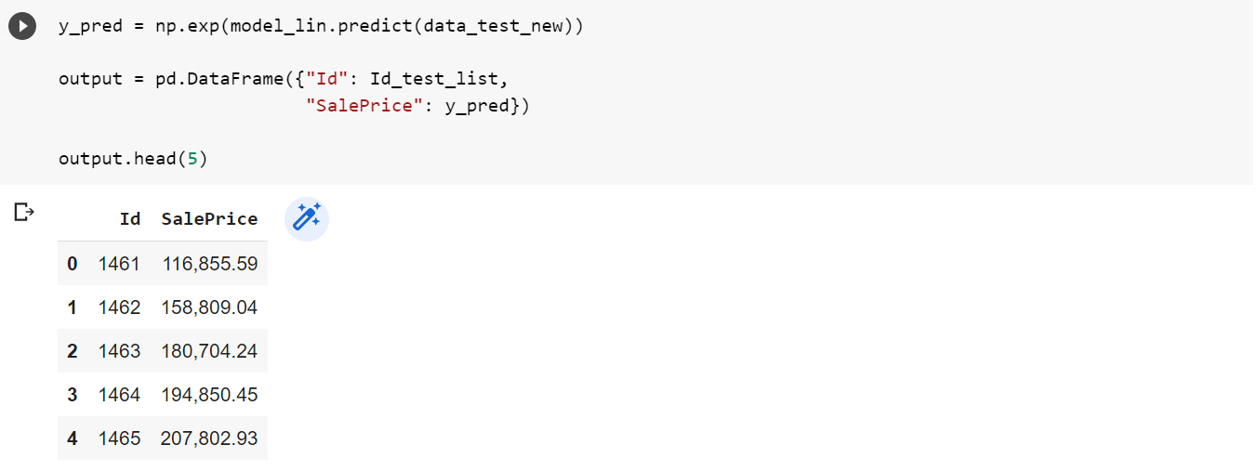
Model Evaluation

Slide 28
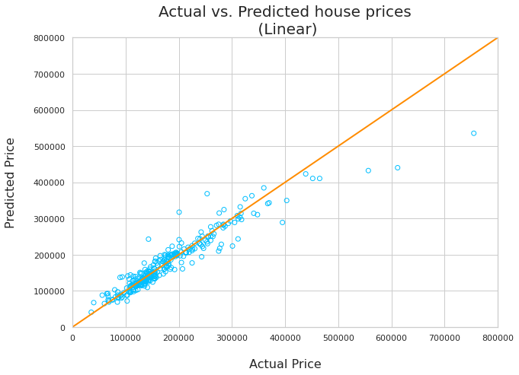

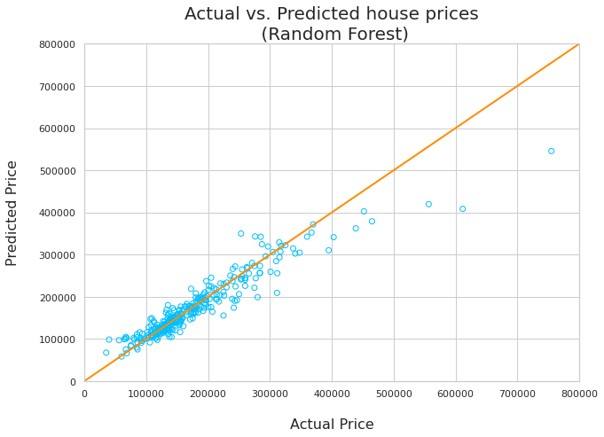
Model Evaluation

Slide 29
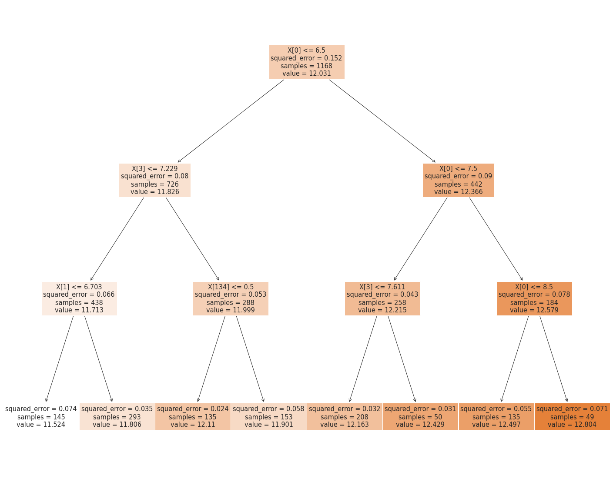
Model Evaluation (Decision Tree)

Slide 30
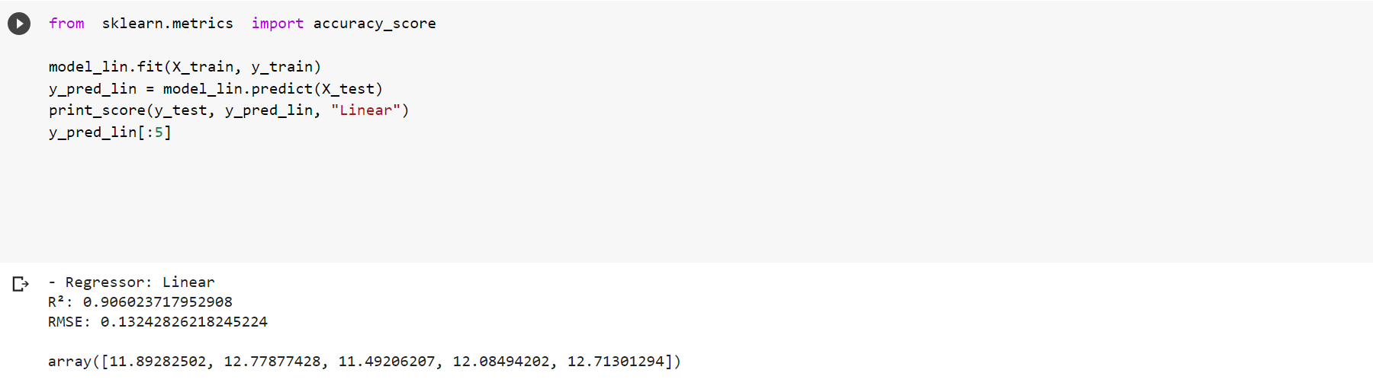
Model Evaluation (Linear Regression)

Slide 31
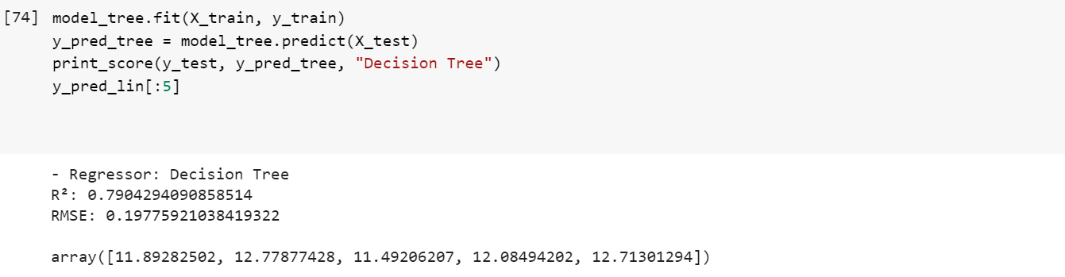
Model Evaluation (Decision Tree)

Slide 32
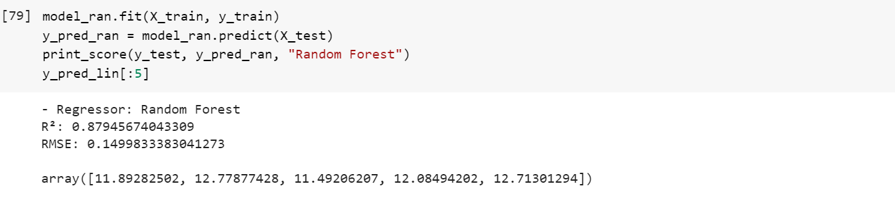
Model Evaluation (Random Forest)

Slide 33
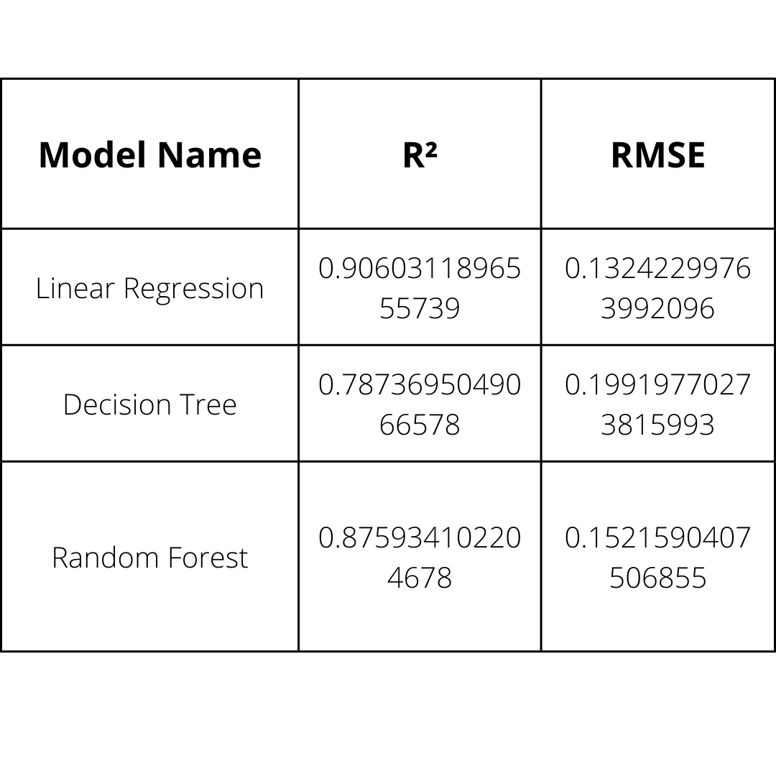
Findings
Median used to fix Numerical Missing Values
Mean used to fix Numerical Missing Values

Slide 34


Slide 35
Thank You

